Slide 1
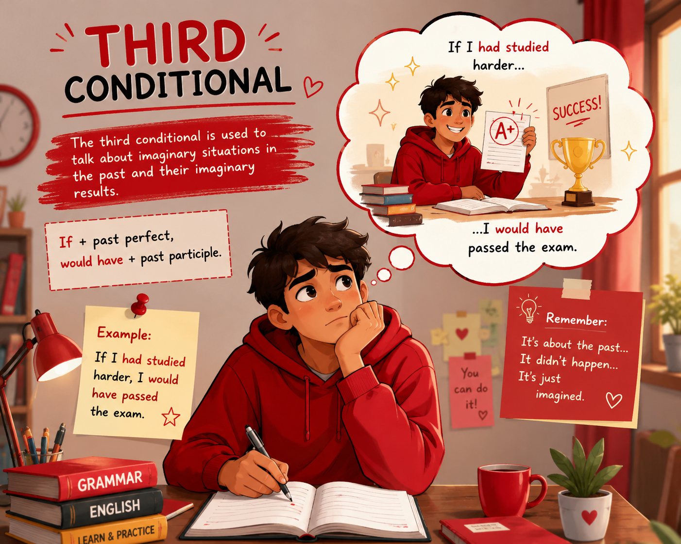

Slide 2
THIRD CONDITIONAL (TYPE 3)
The Third Conditional is used to talk about:
    Unreal past situations
    Things that did not happen in the past
    Regrets
    Criticism
    Imagined past results
In Type 3, both the condition and the result are impossible now because the past cannot be changed.

Slide 3
BASIC FORM
If + S + had + V3, S + would have + V3
If I had known you were coming, I would have met you at the airport.
  Reality: ❌ I didn't know. ❌ I didn't meet you.
If she had called me, I would have helped her.
  Reality: ❌ She didn't call. ❌ I didn't help her.
If he had studied harder, he would have passed the exam.
  Reality: ❌ He didn't study harder. ❌ He didn't pass.

Slide 4
MEANING OF TYPE 3
Type 2: If I had a car, I would drive. (Present/Future unreal)
Type 3: If I had had a car, I would have driven. (Past unreal)
Past: ❌ Condition did not happen ❌ Result did not happen
Example:
If I had woken up earlier, I would have caught the train.
Reality: I didn't wake up early. I missed the train.

Slide 5
MODAL VERBS IN THE MAIN CLAUSE
Would have + V3 - Imagined result in the past.
If I had seen him, I would have spoken to him.
Could have + V3 - Imagined ability / possibility in the past.
If we had found him earlier, we could have saved his life.
Might have + V3 - imagined possibility in the past.
If we had left earlier, we might have caught the train.

Slide 6
TYPE 3 CONTINUOUS RESULT
If + Past Perfect, would/could/might have been + Ving
If Tom's son had not been there, I would have been sitting in the front.
Reality: ❌ Tom's son was there. ❌ I wasn't sitting in front.
If Ali hadn’t brought the book, I couldn't have been preparing for the exam.
Reality: ❌ Ali brought the book.
If I had got the job, I would have been working in Seoul last year.
Reality: ❌ I didn't get the job.

Slide 7
PAST PERFECT CONTINUOUS IN THE IF-CLAUSE
If + S +had been + Ving, S + would have + V3 / would have been + Ving
If Ali had not been wearing a seat belt, he would have been seriously injured.
  Reality: He was wearing a seat belt.
If it had not been snowing heavily, we would not have gone skiing.
  Reality: It was snowing heavily.
If I had been living in Tashkent, I would have been working at a bank.
  Reality: I wasn't living in Tashkent.

Slide 8
PAST CONDITION → PRESENT RESULT (Mixed)
(Type 3 + Type 2) - Past mistake affects the present.
Structure: If + Past Perfect, would/could/might + Verb1
If I had studied harder, I would have a good job now.
  Reality: I didn't study harder. I don't have a good job now.
If she had taken the medicine, she would be better now.
  Reality: She didn't take it. She isn't better now.
If he hadn't missed the flight, he would be here now.
  Reality: He missed the flight. He isn't here.

Slide 9
PRESENT CONDITION → PAST RESULT
(Type 2 + Type 3) - Present unreal situation affected the past.
Structure: If + Past Simple, would/could/might + have + V3
If I were taller, I would have become a basketball player.
  Reality: I'm not tall. I didn't become a basketball player.
If she spoke English well, she would have got the job.
  Reality: She doesn't speak English well. She didn't get the job.
If he weren't so careless, he wouldn't have lost his phone.
  Reality: He is careless. He lost his phone.

Slide 10
Compare All Conditionals
Type | Structure | Meaning
Zero | If + Present, Present | facts, habits
First | If + Present, Will + V | real future possibility
Second | If + Past, Would + V | unreal present/future
Third | If + Past Perfect, Would have + V3 | unreal past
Mixed | Type 3 + Type 2 / Type 2 + Type 3 | past ↔ present connection

Slide 11

Conditional Inversion – Type3
Structure: If + past perfect → Had + subject + V3/ed
  If I had known the truth, I would have told you.
  → Had I known the truth, I would have told you.
  If Iroda had arrived earlier, she would have seen Tomsonjon.
  → Had Iroda arrived earlier, she would have seen Tomsonjon.
  If Husanboy had studied harder, he would have passed. →
  If you had come yesterday, you could have learned the topic. →

Slide 12
Conditional Inversion – Type3 - N
Structure: If + subject + had + not + V3 → Had + subject + not + V3
  If I hadn’t studied, I would have failed.
  → Had I not studied, I would have failed.
  If she hadn’t called me, I wouldn’t have known about the exam.
  → Had she not called me, I wouldn’t have known about the exam.
  If they hadn’t arrived on time, they would have missed the train. →
  If you hadn’t helped him yesterday, he couldn’t have finished his work. →

Slide 13
Conditional Inversion – Type Mixed
Structure: If + past perfect → Had + subject + (not) + V3/ed
  If I hadn’t studied hard, I wouldn’t be successful now.
  → Had I not studied hard, I wouldn’t be successful now.
  If she had moved to London, she wouldn’t have this job now.
  → Had she moved to London, she wouldn’t have this job now.
  If Akmal hadn’t trained earlier, he wouldn’t be strong now. →
  If Anvar had tried harder, he would be a doctor now. →

